Slide 1
SQL: Schema Definition, Basic Constraints, and Queries

Slide 2
SQL Introduction
SQL stands for Structured Query Language
Standard language for querying and manipulating data
Data Definition Language (DDL)
Create/alter/delete tables and their attributes
Data Manipulation Language (DML)
Query one or more tables
Insert/delete/modify tuples in tables
Many standards out there: ANSI SQL, SQL92 (a.k.a. SQL2), SQL99 (a.k.a. SQL3), …

Slide 3
Tables in SQL
Table name
Attribute names
Department
DName | Dnumber | MgrSsn | Mgrstartdate
Gizmo | 19 | 324521 | 1992-08-11
Powergizmo | 29 | 624545 | 1982-01-21
SingleTouch | 1 | 986133 | 1912-04-02
MultiTouch | 2 | 1123455 | 2002-08-28
Tuples or rows

Slide 4
CREATE TABLE
Creates a new relation(table) in the database
Specifies relation’s attributes and their data types
Specifies constraints such as NOT NULL , UNIQUE ,CHECK etc…
CREATE TABLE DEPARTMENT (DNAME VARCHAR(10) NOT NULL , DNUMBER INTEGER CHECK(DNUMBER >0 AND DNUMBER <25), MGRSSN CHAR(9), MGRSTARTDATE DATE
);

Slide 5
CREATE SCHEMA
Specifies a new database schema by giving it a name
Example: CREATE SCHEMA COMPANY AUTHORIZATION Zareen;

Slide 6
Additional Data Types
Has DATE, TIME, and TIMESTAMP data types
DATE:
Made up of year-month-day in the format yyyy-mm-dd
TIME:
Made up of hour:minute:second in the format hh:mm:ss
TIME(i):
Made up of hour:minute:second plus i additional digits specifying fractions of a second
format is hh:mm:ss:ii...i
TIMESTAMP:
Has both DATE and TIME components

Slide 7
CREATE DOMAIN
We can declare a domain in SQL
This makes it easier to change the data type of numerous attributes in a schema
Improves Schema readability
Not available in many SQL implementation like (T-SQL)
CREATE DOMAIN SSN_TYPE AS CHAR(9);

Slide 8
Constraints in SQL
CREATE TABLE command allows us to specify the primary key, secondary keys, and foreign keys.
Key attributes can be specified via the PRIMARY KEY and UNIQUE phrases
CREATE TABLE DEPARTMENT
( DNAME VARCHAR(10) NOT NULL, DNUMBER INTEGER NOT NULL, MGRSSN CHAR(9) NULL, MGRSTARTDATE CHAR(9), PRIMARY KEY (DNUMBER), UNIQUE (DNAME), FOREIGN KEY (MGRSSN) REFERENCES EMPLOYEE
);

Slide 9
REFERENTIAL INTEGRITY OPTIONS
We can specify RESTRICT, CASCADE, SET NULL or SET DEFAULT on foreign keys.
CREATE TABLE DEPARTMENT ( DNAME VARCHAR(10) NOT NULL, DNUMBER INTEGER NOT NULL, MGRSSN CHAR(9), MGRSTARTDATE CHAR(9), PRIMARY KEY (DNUMBER), UNIQUE (DNAME), FOREIGN KEY (MGRSSN) REFERENCES EMPLOYEE ON DELETE SET DEFAULT ON UPDATE CASCADE
);
CASCADE : to delete a row with a key referenced by foreign keys in existing rows in other tables, all rows that contain those foreign keys are also deleted.

Slide 10
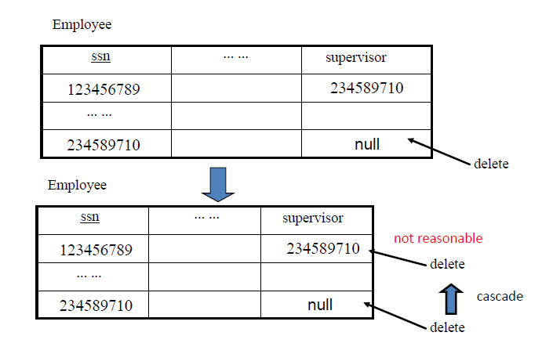
REFERENTIAL INTEGRITY OPTIONS

Slide 11
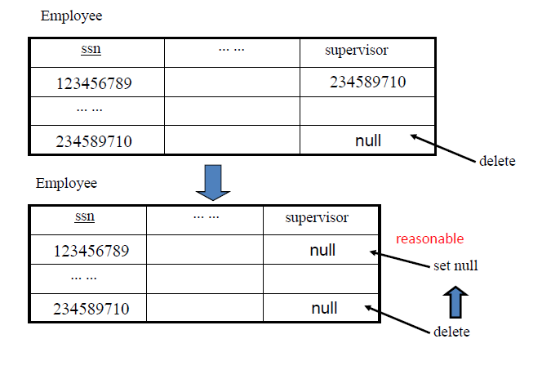
REFERENTIAL INTEGRITY OPTIONS

Slide 12
REFERENTIAL INTEGRITY OPTIONS
CREATE TABLE EMPLOYEE ( ENAME VARCHAR(30) NOT NULL, ESSN CHAR(9), BDATE DATE, DNO INTEGER DEFAULT 1, SUPERSSN CHAR(9), PRIMARY KEY (ESSN), FOREIGN KEY (DNO) REFERENCES DEPARTMENT ON DELETE SET DEFAULT ON UPDATE CASCADE, FOREIGN KEY (SUPERSSN) REFERENCES EMPLOYEE ON DELETE SET NULL ON UPDATE CASCADE
);

Slide 13
SQL CONSTRAINTS
Assigning Names to Constraints
CONSTRAINT deptPK PRIMARY KEY(Dnumber)
CONSTRAINT deptSK UNIQUE(Dname)
CHECK Constraint
CHECK (Dept_create_date <= Mgr_start_date)

Slide 14
DROP COMMAND
Drop Command is used to delete schema or named schema elements such as table, domains, or constraints
Example: DROP TABLE DEPENDENT;
DROP TABLE EMPLOYEE CASCADE;
DROP SCHEMA COMPANY;
In SQL-Server (T-SQL), DROP TABLE cannot be used to drop a table that is referenced by a FOREIGN KEY. The referencing FOREIGN KEY or the referencing table must first be dropped.

Slide 15
ALTER COMMAND
The definition of table or named schema elements can be changed using ALTER command
ALTER can be used to add an attribute to the relation
Initially, the new attribute will have NULLs in all the tuples of the relation
NOT NULL constraint is not allowed for such an attribute
Example : ALTER TABLE EMPLOYEE ADD COLUMN JOB VARCHAR(12); T-SQL syntax
ALTER TABLE EMPLOYEE ADD JOB VARCHAR(12);
The database user have to enter a value for the new attribute JOB for each EMPLOYEE tuple.

Slide 16
ALTER TABLE
ALTER command can be use to add or drop constraints
Example : ALTER TABLE EMPLOYEE add constraint unEmp UNIQUE(NAME) ;
ALTER TABLE EMPLOYEE drop constraint unEmp ;

Slide 17
SQL Queries
Basic form:
SELECT <attributes>
FROM <one or more relations>
WHERE <conditions>
Not same as the SELECT operation of the relational algebra
The result can have duplicate tuples
SQL relation is a multi-set (bag) of tuples; not a set of tuples
Notes:
SQL relations can be constrained to be sets by specifying PRIMARY KEY or UNIQUE attributes, or by using the DISTINCT option in a query

Slide 18
Simple SQL Query
Product
PName | Price | Category | Manufacturer
Gizmo | $19.99 | Gadgets | GizmoWorks
Powergizmo | $29.99 | Gadgets | GizmoWorks
SingleTouch | $149.99 | Photography | Canon
MultiTouch | $203.99 | Household | Hitachi
SELECT * FROM Product WHERE category=‘Gadgets’
PName | Price | Category | Manufacturer
Gizmo | $19.99 | Gadgets | GizmoWorks
Powergizmo | $29.99 | Gadgets | GizmoWorks
“selection”

Slide 19
Simple SQL Query
Product
PName | Price | Category | Manufacturer
Gizmo | $19.99 | Gadgets | GizmoWorks
Powergizmo | $29.99 | Gadgets | GizmoWorks
SingleTouch | $149.99 | Photography | Canon
MultiTouch | $203.99 | Household | Hitachi
SELECT PName, Price, Manufacturer FROM Product WHERE Price > 100
“selection” and
“projection”
PName | Price | Manufacturer
SingleTouch | $149.99 | Canon
MultiTouch | $203.99 | Hitachi

Slide 20
Notation
Input Schema
Product(PName, Price, Category, Manfacturer)
SELECT PName, Price, Manufacturer FROM Product WHERE Price > 100
Answer(PName, Price, Manfacturer)
Output Schema

Slide 21
Eliminating Duplicates
Category
Gadgets
Photography
Household
SELECT DISTINCT category
FROM Product
Compare to:
Category
Gadgets
Gadgets
Photography
Household
SELECT category
FROM Product

Slide 22
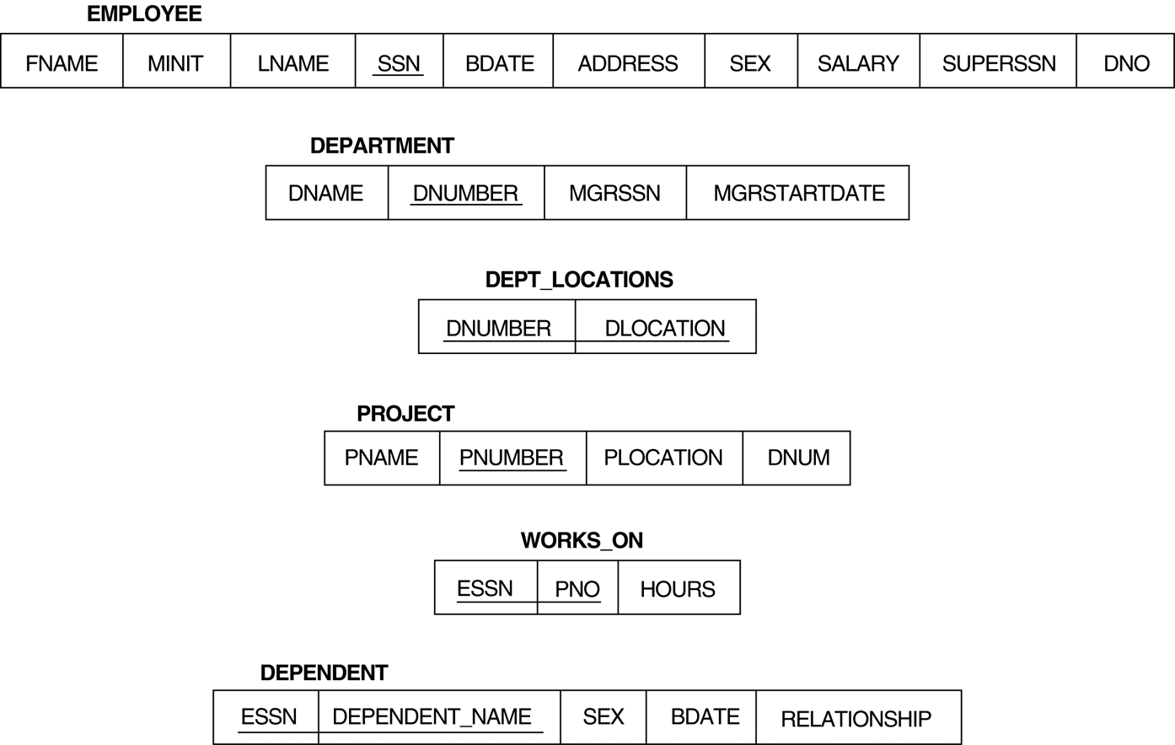
Relational Database Schema

Slide 23
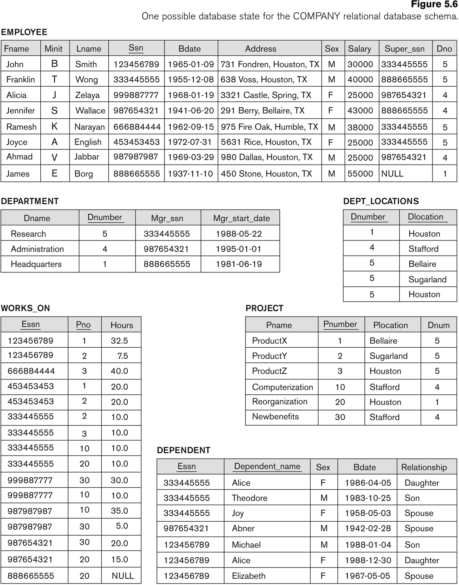
Simple SQL Queries
Basic SQL queries correspond to using the SELECT, PROJECT, and JOIN operations of the relational algebra
Retrieve the birthdate and address of the employee whose name is 'John B. Smith'.
SELECT BDATE, ADDRESS FROM EMPLOYEE WHERE FNAME='John' AND MINIT='B’ AND LNAME='Smith’
Similar to a SELECT-PROJECT pair of relational algebra operations
Notes:
SELECT-clause specifies the projection attributes and the WHERE-clause specifies the selection condition

Slide 24
Join Operation
Retrieve the name and address of all employees who work for the 'Research' department.
SELECT FNAME, LNAME, ADDRESS FROM EMPLOYEE, DEPARTMENT WHERE DNAME='Research' AND DNUMBER=DNO
DNAME='Research’ is a selection condition
DNUMBER=DNO is a join condition

Slide 25
JOIN(cont.)
For every project located in 'Stafford', list the project number, the controlling department number, and the department manager's last name, address, and birthdate.
SELECT PNUMBER, DNUM, LNAME, BDATE, ADDRESS FROM PROJECT, DEPARTMENT, EMPLOYEE WHERE DNUM=DNUMBER AND MGRSSN=SSN AND PLOCATION='Stafford'
Notes:
In above example, there are two join conditions
The join condition DNUM=DNUMBER relates a project to its controlling department
The join condition MGRSSN=SSN relates the controlling department to the employee who manages that department

Slide 26
UNSPECIFIED WHERE-clause
A missing WHERE-clause indicates no condition and is same as WHERE TRUE
Retrieve the SSN values for all employees.
SELECT SSN FROM EMPLOYEE
If there is no join condition, then we get CARTESIAN PRODUCT
SELECT SSN, DNAME FROM EMPLOYEE, DEPARTMENT

Slide 27
USE OF *
To retrieve all the attribute values of the selected tuples, a * is used, which stands for all the attributes Examples:
SELECT * FROM EMPLOYEE WHERE DNO=5 SELECT * FROM EMPLOYEE, DEPARTMENT WHERE DNAME='Research' AND DNO=DNUMBER

Slide 28
Aliases
In SQL, we can use the same name for two (or more) attributes as long as the attributes are in different relations
A query that refers to two or more attributes with the same name must prefix the relation name to the attribute name
Example:
EMPLOYEE.LNAME, DEPARTMENT.DNAME

Slide 29
ALIASES
For each employee, retrieve the employee's name, and the name of his or her immediate supervisor. SELECT E.FNAME, E.LNAME, S.FNAME, S.LNAME FROM EMPLOYEE E S WHERE E.SUPERSSN=S.SSN
Can also use the AS keyword to specify aliases SELECT E.FNAME, E.LNAME, S.FNAME, S.LNAME FROM EMPLOYEE AS E, EMPLOYEE AS S WHERE E.SUPERSSN=S.SSN
Notes:
The alternate relation names E and S are called aliases or tuple variables for the EMPLOYEE relation
We can think of E and S as two different copies of EMPLOYEE; E represents employees in role of supervisees and S represents employees in role of supervisors

Slide 30
ARITHMETIC OPERATIONS
The standard arithmetic operators '+', '-'. '*', and '/’) can be applied to numeric values in an SQL query result
Show the effect of giving all employees who work on the 'ProductX' project a 10% raise.
SELECT FNAME, LNAME, 1.1*SALARY FROM EMPLOYEE, WORKS_ON, PROJECT WHERE SSN=ESSN AND PNO=PNUMBER AND PNAME='ProductX’

Slide 31
ORDER BY
The ORDER BY clause sort the tuples in a query result
Retrieve a list of employees and the projects each works in, ordered by the employee's department, and within each department ordered alphabetically by employee last name.
SELECT DNAME, LNAME, FNAME, PNAME FROM DEPARTMENT, EMPLOYEE, WORKS_ON, PROJECT WHERE DNUMBER=DNO AND SSN=ESSN AND PNO=PNUMBER ORDER BY DNAME, LNAME
The default order is in ascending order of values
We can specify the keyword DESC if we want a descending order

Slide 32
SET OPERATIONS
SQL has incorporated some set operations like
Union operation (UNION),
Set difference (EXCEPT) and
Intersection operation (INTERSECT)
Duplicate tuples are eliminated from the result
Requires union compatible relations

Slide 33
SET OPERATIONS (cont.)
Make a list of all project numbers for projects that involve an employee whose last name is 'Smith' as a worker or as a manager of the department that controls the project. (SELECT PNAME FROM PROJECT, DEPARTMENT, EMPLOYEE WHERE DNUM=DNUMBER AND MGRSSN=SSN AND LNAME='Smith') UNION
(SELECT PNAME FROM PROJECT, WORKS_ON, EMPLOYEE WHERE PNUMBER=PNO AND ESSN=SSN AND LNAME='Smith')

Slide 34
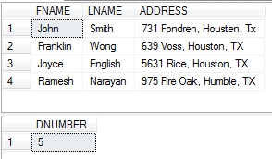
NESTING OF QUERIES
A complete SELECT query, called a nested query , can be specified within the WHERE-clause of another query, called the outer query
Retrieve the name and address of all employees who work for the 'Research' department.
SELECT FNAME, LNAME, ADDRESS FROM EMPLOYEE WHERE DNO IN (SELECT DNUMBER FROM DEPARTMENT WHERE DNAME='Research' )
Notes:
Select fname, lname, address
from Employee,Department
where Dno=Dnumber and Dname='Research‘
The nested query selects the number of the 'Research' department
The outer query select an EMPLOYEE tuple if its DNO value is in the result of nested query
The comparison operator IN compares a value v with a set (or multi-set) of values V, and evaluates to TRUE if v is one of the elements in V

Slide 35
CORRELATED NESTED QUERIES
If a condition in the nested query references an attribute of a relation declared in the outer query , then two queries are said to be correlated
Retrieve the name of each employee who has a dependent with the same first name as the employee.
SELECT E.FNAME, E.LNAME FROM EMPLOYEE AS E WHERE E.SSN IN (SELECT ESSN FROM DEPENDENT WHERE ESSN=E.SSN AND E.FNAME=DEPENDENT_NAME)
Nested query is evaluated once for each tuple in outer query
Notes:
select fname
from Employee, Dependent
where fname=dependent_name and ssn=essn
The result of a correlated nested query is different for each tuple (or combination of tuples) of the relation(s) in the outer query

Slide 36
CORRELATED NESTED QUERIES (cont.)
A query written with nested SELECT... FROM... WHERE... blocks and using the = or IN comparison operators can always be expressed as a single block query. For example, the query on previous slide can be written as SELECT E.FNAME, E.LNAME FROM EMPLOYEE E, DEPENDENT D WHERE E.SSN=D.ESSN AND E.FNAME=D.DEPENDENT_NAME

Slide 37
NESTED QUERIES
CONTAINS operator compares two sets of values , and returns TRUE if one set contains all values in the other set. (same as division operation of relational algebra)
Most implementations of SQL do not have this operator
Retrieve the name of each employee who works on all the projects controlled by department number 5. SELECT FNAME, LNAME FROM EMPLOYEE WHERE ( (SELECT PNO FROM WORKS_ON WHERE SSN=ESSN) CONTAINS (SELECT PNUMBER FROM PROJECT WHERE DNUM=5) )

Slide 38
THE EXISTS FUNCTION
EXISTS is used to check whether the result of a correlated nested query is empty or not
Formulate Query given below using EXISTS
Retrieve the name of each employee who has a dependent with the same first name as the employee.
SELECT FNAME, LNAME FROM EMPLOYEE WHERE EXISTS (SELECT * FROM DEPENDENT WHERE SSN=ESSN AND FNAME=DEPENDENT_NAME)

Slide 39
EXISTS FUNCTION (cont.)
Retrieve the names of employees who have no dependents. SELECT FNAME, LNAME FROM EMPLOYEE WHERE NOT EXISTS (SELECT * FROM DEPENDENT WHERE SSN=ESSN)
The above correlated nested query retrieves all DEPENDENT tuples related to an EMPLOYEE tuple. If none exist , the EMPLOYEE tuple is selected
EXISTS is necessary for the expressive power of SQL

Slide 40
EXISTS FUNCTION (cont.)
Retrieve the name of each employee who works on all the projects controlled by department number 5.
Set theory: S1 contains S2 == S2 – S1 SELECT FNAME, LNAME FROM EMPLOYEE WHERE NOT EXISTS ( (SELECT PNUMBER FROM PROJECT WHERE DNUM=5) EXCEPT (SELECT PNO FROM WORKS_ON WHERE SSN=ESSN) )

Slide 41
NESTED CORRELATED QUERIES (contd)
You can also use: s > ALL R
s > ANY R
EXISTS R
Product ( pname, price, category, maker)
Find products that are more expensive than all those produced
By “Gizmo-Works”
SELECT name
FROM Product
WHERE price > ALL (SELECT price
FROM Purchase
WHERE maker=‘Gizmo-Works’)

Slide 42
Complex Correlated Query
Product ( pname, price, category, maker, year)
Find products (and their manufacturers) that are more expensive than all products made by the same manufacturer before 1972
Very powerful ! Also much harder to optimize.
SELECT DISTINCT pname, maker
FROM Product AS x
WHERE price > ALL (SELECT price
FROM Product AS y
WHERE x.maker = y.maker AND y.year < 1972);

Slide 43
EXPLICIT SETS
It is also possible to use an explicit (enumerated) set of values in the WHERE-clause rather than a nested query
Retrieve the social security numbers of all employees who work on project number 1, 2, or 3.
SELECT DISTINCT ESSN FROM WORKS_ON WHERE PNO IN (1, 2, 3)

Slide 44
NULLS IN SQL QUERIES
SQL allows queries that check if a value is NULL
SQL uses IS or IS NOT to compare NULLs
As it considers each NULL value distinct from other NULL values, so equality comparison is not appropriate .
Retrieve the names of all employees who do not have supervisors. SELECT FNAME, LNAME FROM EMPLOYEE WHERE SUPERSSN IS NULL
Note: If a join condition is specified, tuples with NULL values for the join attributes are not included in the result

Slide 45
Joined Relations in SQL
Allows the user to specify different types of joins (regular "theta" JOIN, NATURAL JOIN, LEFT OUTER JOIN, RIGHT OUTER JOIN, CROSS JOIN, etc )
Example: SELECT E.FNAME, E.LNAME, S.FNAME, S.LNAME FROM EMPLOYEE AS E , EMPLOYEE AS S WHERE E.SUPERSSN=S.SSN
SELECT E.FNAME, E.LNAME, S.FNAME, S.LNAME FROM (EMPLOYEE E JOIN EMPLOYEE S ON E.SUPERSSN=S.SSN SELECT E.FNAME, E.LNAME, S.FNAME, S.LNAME FROM (EMPLOYEE E LEFT OUTER JOIN EMPLOYEE S ON E.SUPERSSN=S.SSN)

Slide 46
Joined Relations Feature in SQL
SELECT FNAME, LNAME, ADDRESS FROM EMPLOYEE, DEPARTMENT WHERE DNAME='Research' AND DNUMBER=DNO
could be written as: SELECT FNAME, LNAME, ADDRESS FROM (EMPLOYEE JOIN DEPARTMENT ON DNUMBER=DNO) WHERE DNAME='Research’ or as: SELECT FNAME, LNAME, ADDRESS FROM (EMPLOYEE NATURAL JOIN DEPARTMENT AS DEPT(DNAME, DNO, MSSN, MSDATE) WHERE DNAME='Research’

Slide 47
Joined Relations Feature in SQL
Example that illustrates multiple joins SELECT PNUMBER, DNUM, LNAME, FROM (PROJECT JOIN DEPARTMENT
ON DNUM=DNUMBER)
JOIN EMPLOYEE ON MGRSSN=SSN) ) WHERE PLOCATION='Stafford’

Slide 48
AGGREGATE FUNCTIONS
Include COUNT, SUM, MAX, MIN, and AVG
Find the maximum salary, the minimum salary, and the average salary among all employees. SELECT MAX(SALARY), MIN(SALARY), AVG(SALARY) FROM EMPLOYEE
Some SQL implementations may not allow more than one function in the SELECT-clause

Slide 49
AGGREGATE FUNCTIONS (cont.)
Retrieve the the number of employees in the 'Research' department SELECT COUNT (*) FROM EMPLOYEE, DEPARTMENT WHERE DNO=DNUMBER AND DNAME='Research’

Slide 50
GROUPING
In many cases, we want to apply the aggregate functions to subgroups of tuples in a relation
The function is applied to each subgroup independently
SQL has a GROUP BY-clause for specifying the grouping attributes
For each department, retrieve the department number, the number of employees in the department, and their average salary. SELECT DNO, COUNT (*), AVG (SALARY) FROM EMPLOYEE GROUP BY DNO
Notes:
Each subgroup of tuples consists of the set of tuples that have the same value for the grouping attribute(s)

Slide 51
GROUPING (cont.)
For each project, retrieve the project number, project name, and the number of employees who work on that project. SELECT PNUMBER, PNAME, COUNT (*) FROM PROJECT, WORKS_ON WHERE PNUMBER=PNO GROUP BY PNUMBER, PNAME
In this case, the grouping and functions are applied after the joining of the two relations
Group By clause specifies grouping attributes which should appear in SELECT clause

Slide 52
THE HAVING-CLAUSE
HAVING-clause is used for specifying a selection condition on groups (rather than on individual tuples)
For each project on which more than two employees work , retrieve the project number, project name, and the number of employees who work on that project. SELECT PNUMBER, PNAME, COUNT (*) FROM PROJECT, WORKS_ON WHERE PNUMBER=PNO GROUP BY PNUMBER, PNAME HAVING COUNT (*) > 2

Slide 53
THE HAVING-CLAUSE (cont.)
For each project on which more than two employees work , retrieve the project number, project name, and the number of employees who work on that project. SELECT PNUMBER, PNAME, COUNT(*) FROM PROJECT, WORKS_ON WHERE PNUMBER=PNO GROUP BY PNUMBER, PNAME HAVING COUNT (*) > 2

Slide 54
General form of Grouping and Aggregation
SELECT S
FROM R₁,…,R_{n}
WHERE C1
GROUP BY a₁,…,a_{k}
HAVING C2
Evaluation steps:
Evaluate FROM-WHERE, apply condition C1
Group by the attributes a₁,…,a_{k}
Apply condition C2 to each group (may have aggregates)
Compute aggregates in S and return the result

Slide 55
Two Examples
Store(sid, sname)
Product(pid, pname, price, sid)
Find all stores that sell only products with price > 100
same as:
Find all stores s.t. all their products have price > 100)

Slide 56
SELECT Store.name
FROM Store, Product
WHERE Store.sid = Product.sid
GROUP BY Store.sid, Store.name
HAVING 100 < min(Product.price)
Why both ?
SELECT Store.name
FROM Store
WHERE 100 < ALL (SELECT Product.price FROM product WHERE Store.sid = Product.sid)
Almost equivalent…
SELECT Store.name
FROM Store
WHERE Store.sid NOT IN
(SELECT Product.sid
FROM Product
WHERE Product.price <= 100)

Slide 57
SUBSTRING COMPARISON
The LIKE comparison operator is used to compare partial strings
Two reserved characters are used:
'%' (or '*' in some implementations) replaces an arbitrary number of characters, and
'_' replaces a single arbitrary character
Retrieve all employees whose address is in Houston, Texas. SELECT FNAME, LNAME FROM EMPLOYEE WHERE ADDRESS LIKE '%Houston,TX%’

Slide 58
SUBSTRING COMPARISON (cont.)
Retrieve all employees who were born during the 1950s.
Here, '5' must be the 8th character of the string (according to our format for date), so the BDATE value is '_______5_', with each underscore as a place holder for a single arbitrary character. SELECT FNAME, LNAME FROM EMPLOYEE WHERE BDATE LIKE '_______5_’
The LIKE operator allows us to get around the fact that each value is considered atomic and indivisible; hence, in SQL, character string attribute values are not atomic

Slide 59
Summary of SQL Queries
A query in SQL can consist of up to six clauses, but only the first two, SELECT and FROM, are mandatory. The clauses are specified in the following order: SELECT <attribute list> FROM <table list> [WHERE <condition>] [GROUP BY <grouping attribute(s)>] [HAVING <group condition>] [ORDER BY <attribute list>]
A query is evaluated by first applying the WHERE-clause, then GROUP BY and HAVING, and finally the SELECT-clause

Slide 60
Summary of SQL Queries (cont.)
The SELECT-clause lists the attributes or functions to be retrieved
The FROM-clause specifies all relations (or aliases) needed in the query but not those needed in nested queries
The WHERE-clause specifies the conditions for selection and join of tuples from the relations specified in the FROM-clause
GROUP BY specifies grouping attributes
HAVING specifies a condition for selection of groups
ORDER BY specifies an order for displaying the result of a query

Slide 61
Specifying Updates in SQL
There are three SQL commands to modify the database;
INSERT,
DELETE, and
UPDATE

Slide 62
INSERT
In its simplest form, it is used to add one or more tuples to a relation
Attribute values should be listed in the same order as the attributes were specified in the CREATE TABLE command
Example: INSERT INTO EMPLOYEE VALUES ('Richard','K','Marini', '653298653', '30-DEC-52', '98 Oak Forest,Katy,TX', 'M', 37000,'987654321', 4 )

Slide 63
INSERT (cont.)
An alternate form of INSERT specifies explicitly the attribute names that correspond to the values in the new tuple
Attributes with NULL values can be left out
Example: Insert a tuple for a new EMPLOYEE for whom we only know the FNAME, LNAME, and SSN attributes. INSERT INTO EMPLOYEE (FNAME, LNAME, SSN) VALUES ('Richard', 'Marini', '653298653')

Slide 64
INSERT (cont.)
Suppose we want to create a temporary table that has the name, number of employees, and total salaries for each department.
A table DEPTS_INFO is created by Q1, and is loaded with the information retrieved from the database by the query Q2. Q1: CREATE TABLE DEPTS_INFO (DEPT_NAME VARCHAR(10), NO_OF_EMPS INTEGER, TOTAL_SAL INTEGER); Q2: INSERT INTO DEPTS_INFO (DEPT_NAME, NO_OF_EMPS, TOTAL_SAL) SELECT DNAME, COUNT (*), SUM (SALARY) FROM DEPARTMENT, EMPLOYEE WHERE DNUMBER=DNO GROUP BY DNAME ;
Notes:
Note: The DEPTS_INFO table may not be up-to-date if we change the tuples in either the DEPARTMENT or the EMPLOYEE relations after issuing U3B. We have to create a view (see later) to keep such a table up to date.

Slide 65
DELETE
Removes tuples from a relation
Tuples are deleted from only one table at a time (unless CASCADE is specified on a referential integrity constraint)
Examples: DELETE FROM EMPLOYEE WHERE LNAME='Brown’ DELETE FROM EMPLOYEE WHERE DNO IN (SELECT DNUMBER FROM DEPARTMENT WHERE DNAME='Research')
DELETE FROM EMPLOYEE
Notes:
A missing WHERE-clause specifies that all tuples in the relation are to be deleted; the table then becomes an empty table
Includes a WHERE-clause to select the tuples to be deleted

Slide 66
UPDATE
Used to modify attribute values of selected tuples
Example: Change the location and controlling department number of project number 10 to 'Bellaire' and 5, respectively. UPDATE PROJECT SET PLOCATION = 'Bellaire', DNUM = 5 WHERE PNUMBER=10
Notes:
A WHERE-clause selects the tuples to be modified
An additional SET-clause specifies the attributes to be modified and their new values
Each command modifies tuples in the same relation
Referential integrity should be enforced

Slide 67
UPDATE (cont.)
Example: Give all employees in the 'Research' department a 10% raise in salary. UPDATE EMPLOYEE SET SALARY = SALARY *1.1 WHERE DNO IN (SELECT DNUMBER FROM DEPARTMENT WHERE DNAME='Research')
Notes:
In this request, the modified SALARY value depends on the original SALARY value in each tuple
The reference to the SALARY attribute on the right of = refers to the old SALARY value before modification
The reference to the SALARY attribute on the left of = refers to the new SALARY value after modificatio

Slide 68
Defining Views
Views are relations, except that they are not physically stored.
They are used to:
simplify complex queries, and
define distinct conceptual interfaces for different users.
Example view: purchases of telephony products.
CREATE VIEW Works_ON1 AS
SELECT fname,lname,pname,hours
FROM Employee,Project,works_on
WHERE ssn=essn AND pno=pnumber
The view is materialized when its results are stored in the DBMS.

Slide 69
A Different View
CREATE VIEW Seattle-view AS
SELECT buyer, seller, product, store
FROM Person, Purchase
WHERE Person.city = ‘Seattle’ AND
Person.per-name = Purchase.buyer
We can later use the views:
SELECT name, store
FROM Seattle-view, Product
WHERE Seattle-view.product = Product.name AND
Product.category = ‘shoes’
What’s really happening when we query a view?? It’s unfolded.

Slide 70
Updating Views
How can I insert a tuple into a table that doesn’t exist?
CREATE VIEW bon-purchase AS
SELECT store, seller, product (note: buyer is not selected)
FROM Purchase
WHERE store = ‘The Bon Marche’
If we make the following insertion:
INSERT INTO bon-purchase
VALUES (‘the Bon Marche’, ‘Joe’, ‘Denby Mug’)
We can simply add a tuple
(‘the Bon Marche’, ‘Joe’, NULL, ‘Denby Mug’)
to relation Purchase.

Slide 71
Non-Updatable Views
CREATE VIEW Seattle-view AS
SELECT seller, product, store
FROM Person, Purchase
WHERE Person.city = ‘Seattle’ AND
Person.name = Purchase.buyer
How can we add the following tuple to the view?
(‘Joe’, ‘Shoe Model 12345’, ‘Nine West’)
In principle, two tuples should be added to the database:
Person: (foo, NullPhoneNumber, ‘Seattle’)
Purchase: (foo, ‘Joe’, ‘Nine West’, ‘Shoe Model 12345’)
But it’s very hard to manage the foo’s later, so this update is not legal.

Slide 72
Reusing a Materialized View
Suppose I have only the result of SeattleView:
SELECT buyer, seller, product, store
FROM Person, Purchase
WHERE Person.city = ‘Seattle’ AND
Person.per-name = Purchase.buyer
and I want to answer the query
SELECT buyer, seller
FROM Person, Purchase
WHERE Person.city = ‘Seattle’ AND
Person.per-name = Purchase.buyer AND
Purchase.product=‘gizmo’.
Then, I can rewrite the query using the view.

Slide 73
Query Rewriting Using Views
Rewritten query:
SELECT buyer, seller
FROM SeattleView
WHERE product= ‘gizmo’
Original query:
SELECT buyer, seller
FROM Person, Purchase
WHERE Person.city = ‘Seattle’ AND
Person.per-name = Purchase.buyer AND
Purchase.product=‘gizmo’.

Slide 74
Querying the WWW
Assume a virtual schema of the WWW, e.g.,
Course(number, university, title, prof, quarter)
Every data source on the web contains the answer to a view over the virtual schema:
UW database: SELECT number, title, prof
FROM Course
WHERE univ=‘UW’ AND quarter=‘4/99’
Stanford database: SELECT number, title, prof, quarter
FROM Course
WHERE univ=‘Stanford’
User query: find all professors who teach “database systems”

Slide 75
Triggers
Enable the database programmer to specify:
when to check a constraint,
what exactly to do.
A trigger has 3 parts:
An event (e.g., update to an attribute)
A condition (e.g., a query to check)
An action (deletion, update, insertion)
When the event happens, the system will check the constraint, and
if satisfied, will perform the action.
NOTE: triggers may cause cascading effects.
Database vendors did not wait for standards with triggers!

Slide 76
Elements of Triggers (in SQL3)
Timing of action execution: before, after or instead of triggering
event
The action can refer to both the old and new state of the database.
Update events may specify a particular column or set of columns.
A condition is specified with a WHEN clause.
The action can be performed either for
once for every tuple, or
once for all the tuples that are changed by the database operation.

